Slide 1


MIT School of Computing Department of Computer Science & Engineering
Third Year Engineering
23CSE3011 - Design and Analysis of Algorithms
Class - T.Y. (SEM-V)
Unit - II
Brute Force and Divide-and-Conquer
PLD
AY 2026-2027 SEM-V

Slide 2
MIT School of Computing Department of Computer Science & Engineering
Unit-II - Syllabus
Brute Force: Principle, Brute force string matching algorithm and its analysis, NAÏVE string matching algorithms and its analysis, Rabin Karp algorithm and its analysis;
Divide-and-Conquer Methodology: Principle, algorithms: Binary Search and its analysis, Merge sort and its analysis, Quick sort and its analysis, Stassen’s matrix multiplication.
PLD

Slide 3
MIT School of Computing Department of Computer Science & Engineering
Brute Force: Principle
A Brute Force Algorithm is the straight forward approach to a problem i.e., the first approach that comes to our mind on seeing the problem.
More technically it is just like iterating every possibility available to solve that problem.
Ex: Searching a String Pattern in Given Text
Calculating Power of N
Sorting an elements etc
when the problem size is limited it is useful.
The method is also used when the simplicity of implementation is more important than speed.
PLD

Slide 4
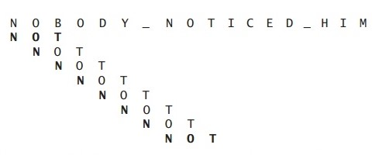
MIT School of Computing Department of Computer Science & Engineering
Brute force String Matching Algorithm and its analysis -
What is String Matching:
Identify the index of String (m) in Given Text (P)
where m < p
Search for string ‘ NOT ‘ in the Text “ NOBODY NOTICED HIM’
PLD

Slide 5
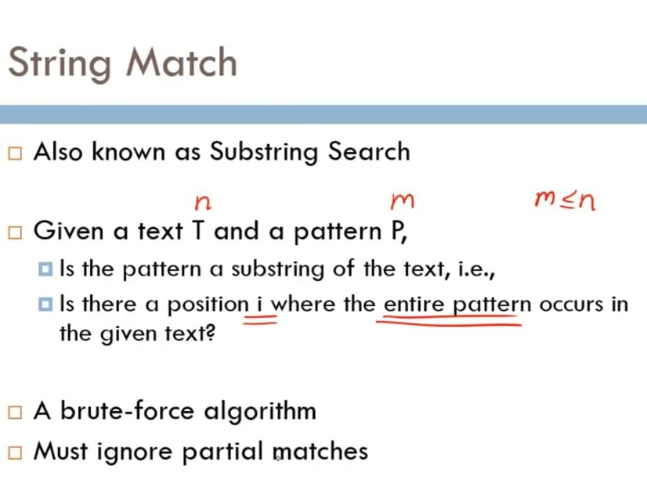
MIT School of Computing Department of Computer Science & Engineering
Brute force string matching algorithm
PLD

Slide 6
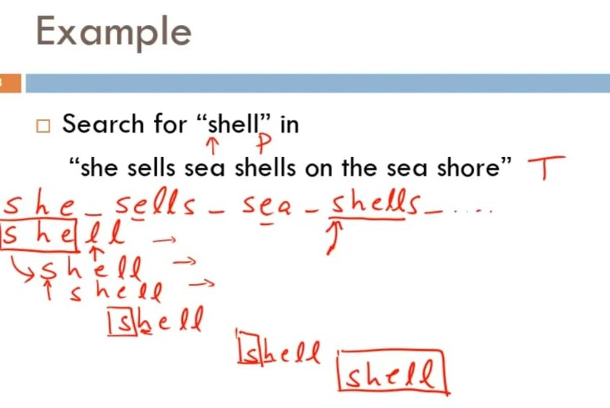
MIT School of Computing Department of Computer Science & Engineering
PLD

Slide 7
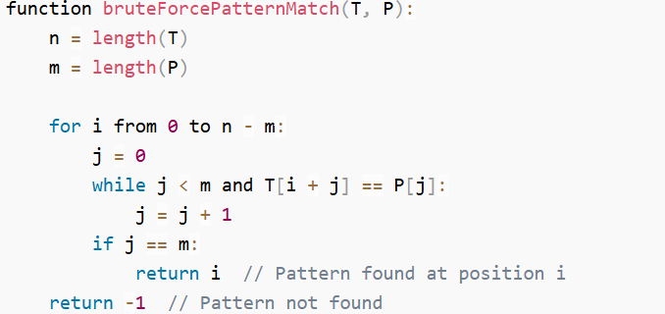
MIT School of Computing Department of Computer Science & Engineering
PLD

Slide 8
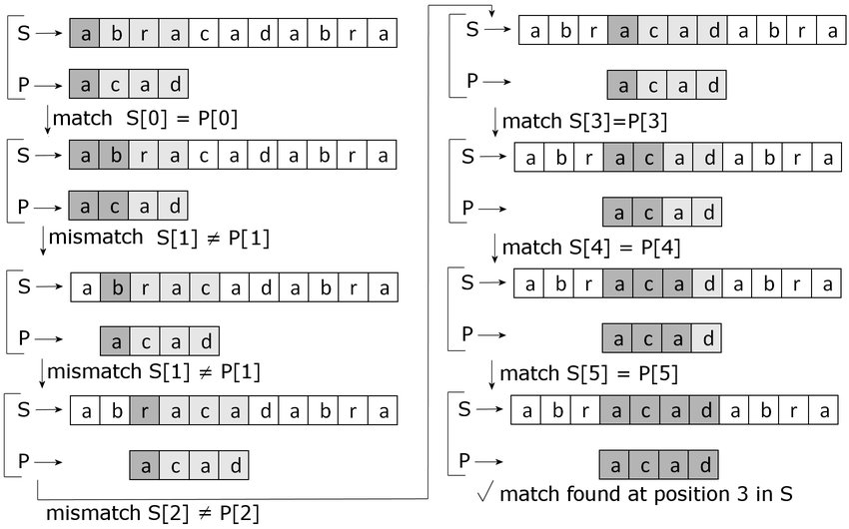
MIT School of Computing Department of Computer Science & Engineering
PLD

Slide 9
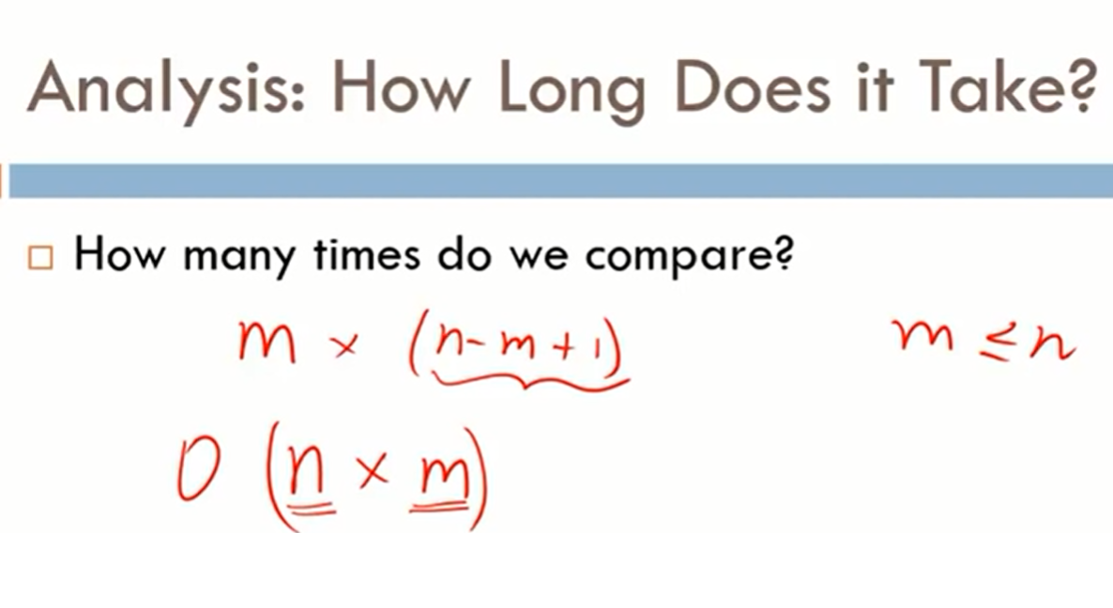
MIT School of Computing Department of Computer Science & Engineering
PLD

Slide 10
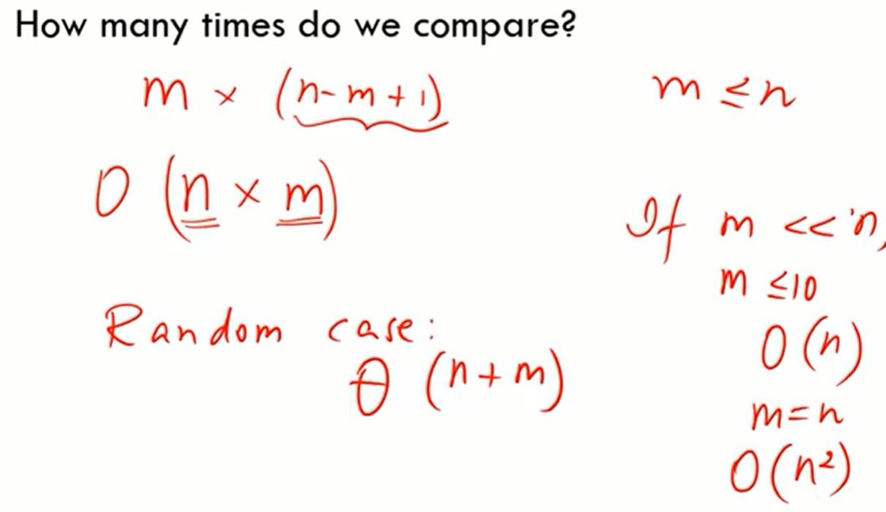
MIT School of Computing Department of Computer Science & Engineering
PLD

Slide 11
MIT School of Computing Department of Computer Science & Engineering
NAÏVE string matching algorithms and its analysis -
Finding all occurrences of a pattern in a given text(or body of text).
Naive algorithm is exact string matching(means finding one or all exact occurrences of a pattern in a text) algorithm.
The naive approach tests all the possible placement of Pattern P [1…….m] relative to text T [1……n].
We try shift s = 0, 1…….n-m, successively and for each shift s.
Compare T [s+1…….s+m] to P [1……m].It returns all the valid shifts found.
PLD

Slide 12
MIT School of Computing Department of Computer Science & Engineering
NAÏVE string matching algorithms and its analysis
Example:
Input: txt[] = "THIS IS STRING MATCHING ALGORITHM"
pat[] = "STRING"
Output: Pattern found at position 10
PLD

Slide 13
MIT School of Computing Department of Computer Science & Engineering
NAÏVE string matching algorithms and its analysis -
Example -
Input Main String : “ABAAABCDBBABCDDEBCABC”
Pattern : “ABC”
Output :
Pattern found at position: 4
Pattern found at position: 10
Pattern found at position: 18
PLD

Slide 14
MIT School of Computing Department of Computer Science & Engineering
NAÏVE string matching algorithm -
NAIVE-STRING-MATCHER (T, P)
n ← length [T]
m ← length [P]
for s ← 0 to n -m
do if P [1.....m] = T [s + 1....s + m]
then print "Pattern occurs with shift"
Analysis: This for loop from 3 to 5 executes for n-m + 1(we need at least m characters at the end) times and in iteration we are doing m comparisons. So the total complexity is O (n-m+1).
PLD

Slide 15
MIT School of Computing Department of Computer Science & Engineering
NAÏVE string matching algorithm analysis
What is the best case - The best case occurs when the first character of the pattern is not present in text at all.
txt[] = "BBACCAADDEE";
pat[] = "HBB";
The number of comparisons in best case is O(n).
PLD

Slide 16
MIT School of Computing Department of Computer Science & Engineering
NAÏVE string matching algorithm analysis
What is the worst case - The worst case of Naive Pattern Searching occurs in following scenarios.
1) When all characters of the text and pattern are same.
txt[] = "DDDDDDDDDDDD";
pat[] = "DDDDD";
2) Worst case also occurs when only the last character is different.
txt[] = "VVVVVVVVVVVVK";
pat[] = "VVVK";
The number of comparisons in the worst case is O(m*(n-m+1)).
PLD

Slide 17
MIT School of Computing Department of Computer Science & Engineering
Rabin Karp algorithm and its analysis;
It is String matching algorithm.
It is another application of Hashing.
The Rabin-Karp string searching algorithm calculates a hash value for the pattern, and for each M-character subsequence of text to be compared.
If the hash values are unequal, the algorithm will calculate the hash value for next M-character sequence.
If the hash values are equal, the algorithm will compare the pattern and the M-character sequence.
In this way, there is only one comparison per text subsequence, and character matching is only needed when hash values match.
PLD

Slide 18
MIT School of Computing Department of Computer Science & Engineering
Rabin Karp algorithm -
RABIN-KARP-MATCHER (T, P, d, q)
n ← length [T]
m ← length [P]
h ← d mod q
p ← 0
t₀ ← 0
for i ← 1 to m
do p ← (dp + P[i]) mod q
t₀ ← (dt₀+T [i]) mod q
for s ← 0 to n-m
do if p = t_{s}
then if P [1.....m] = T [s+1.....s + m]
then "Pattern occurs with shift" s
If s < n-m
1then t_{s+1} ← (d (t_{s}-T [s+1]h)+T [s+m+1])mod q
PLD

Slide 19
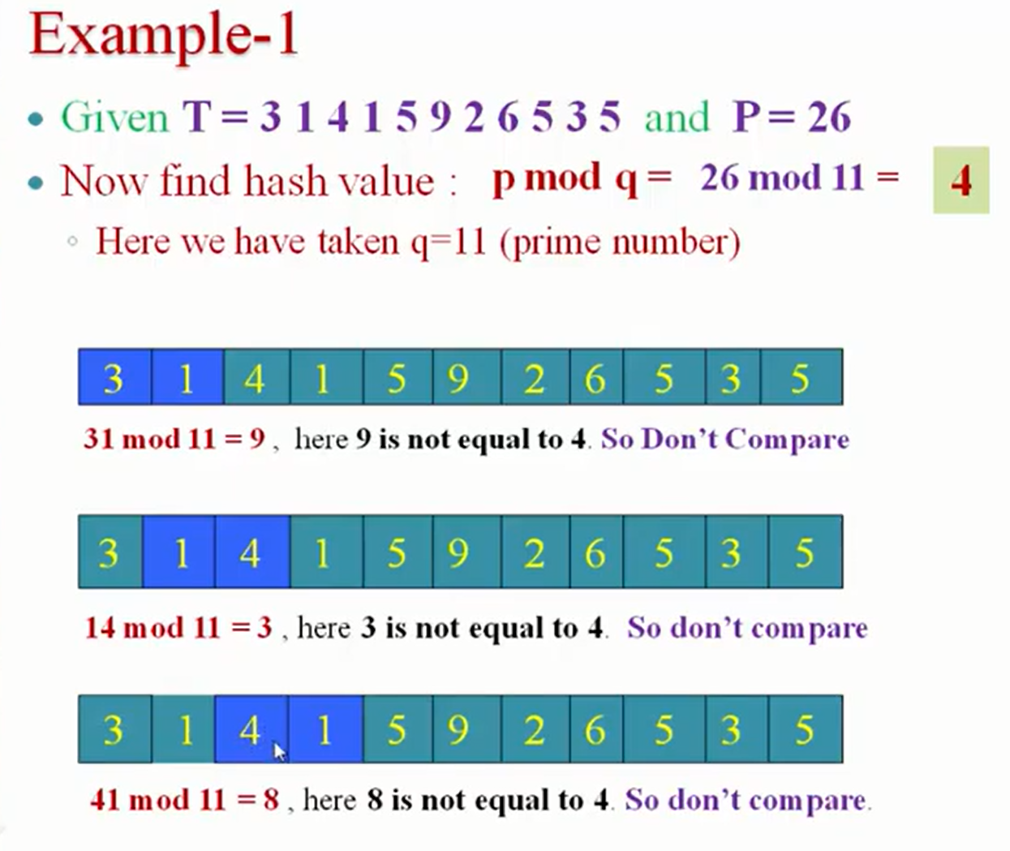
MIT School of Computing Department of Computer Science & Engineering
Rabin Karp algorithm
PLD

Slide 20
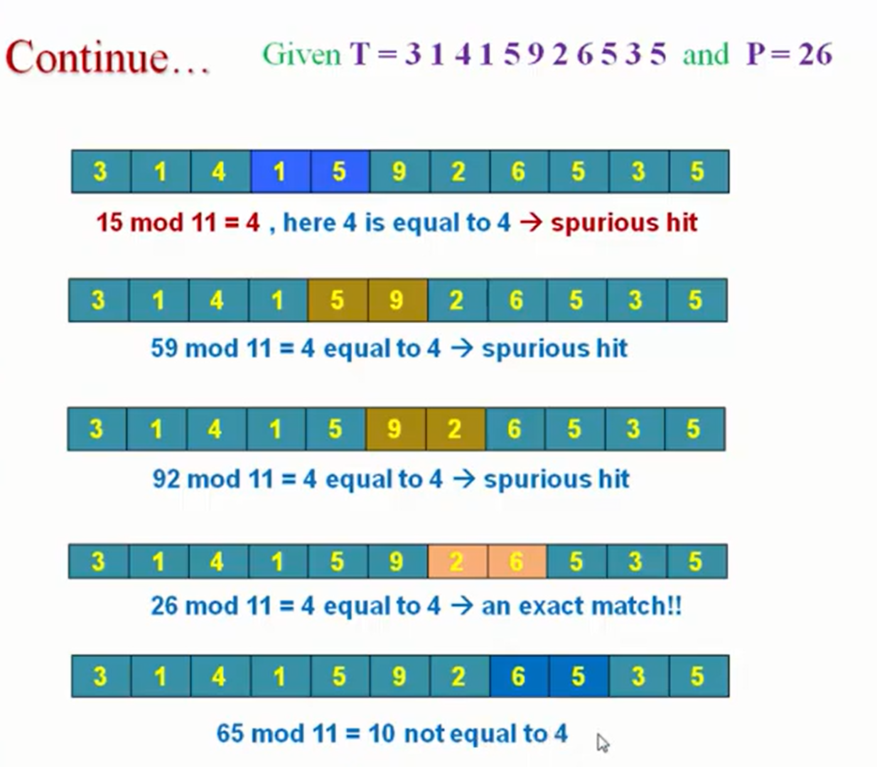
MIT School of Computing Department of Computer Science & Engineering
Rabin Karp algorithm
PLD

Slide 21
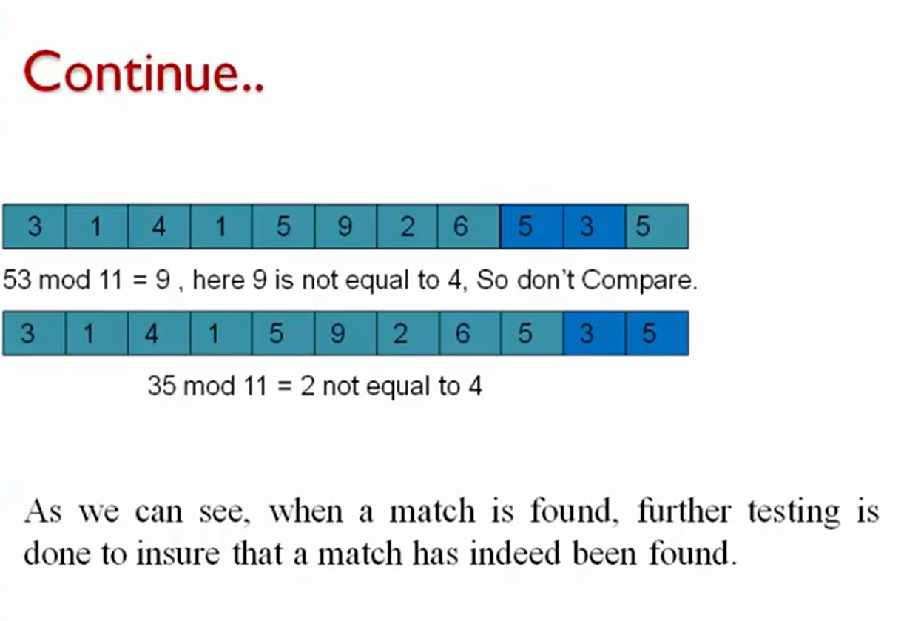
MIT School of Computing Department of Computer Science & Engineering
Rabin Karp algorithm
PLD

Slide 22
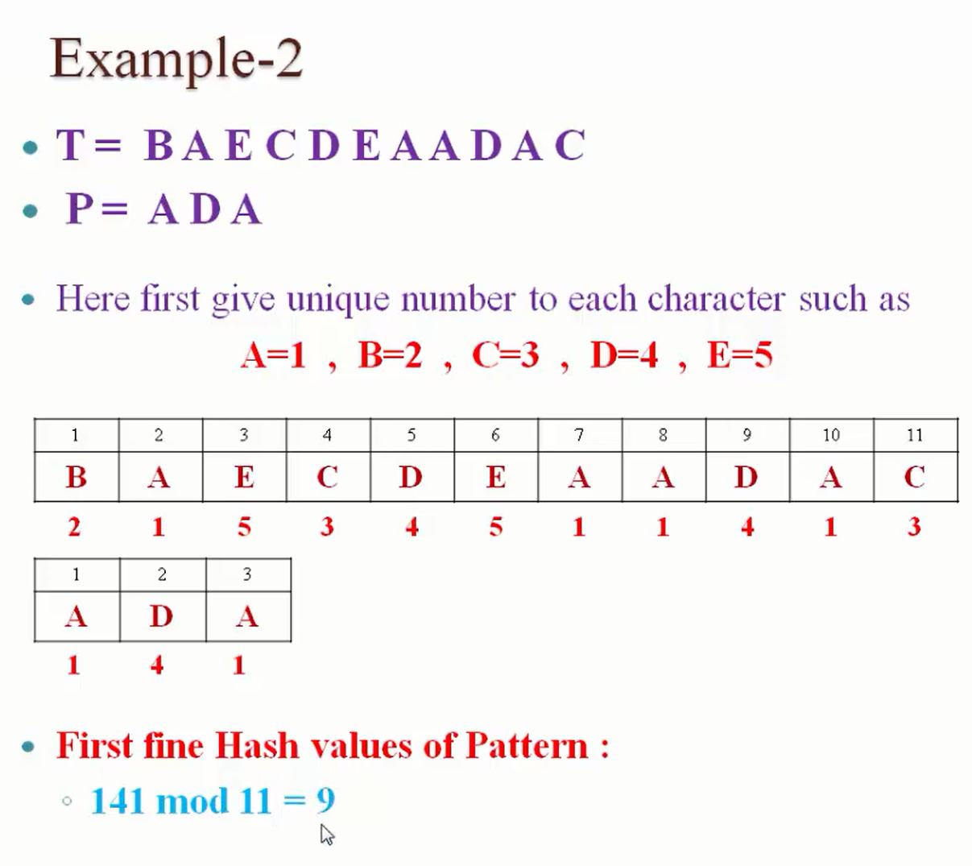
MIT School of Computing Department of Computer Science & Engineering
Rabin Karp algorithm
PLD

Slide 23
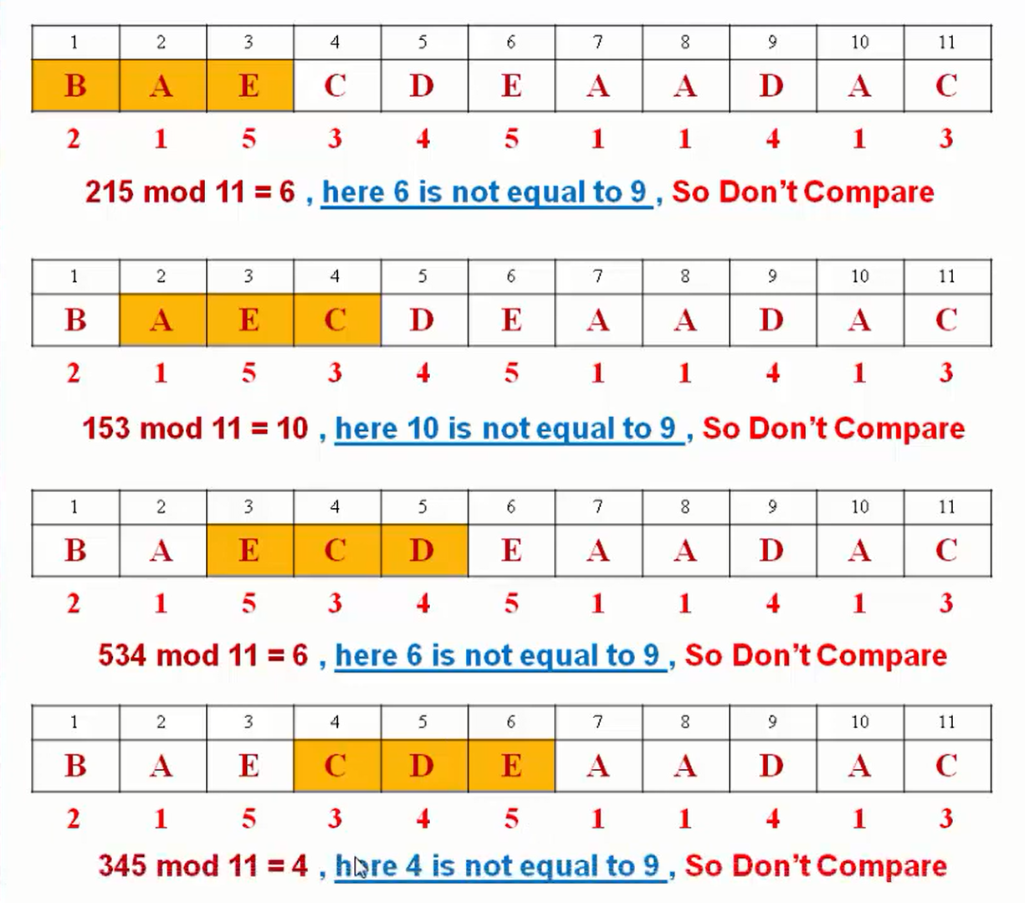
MIT School of Computing Department of Computer Science & Engineering
Rabin Karp algorithm
PLD

Slide 24
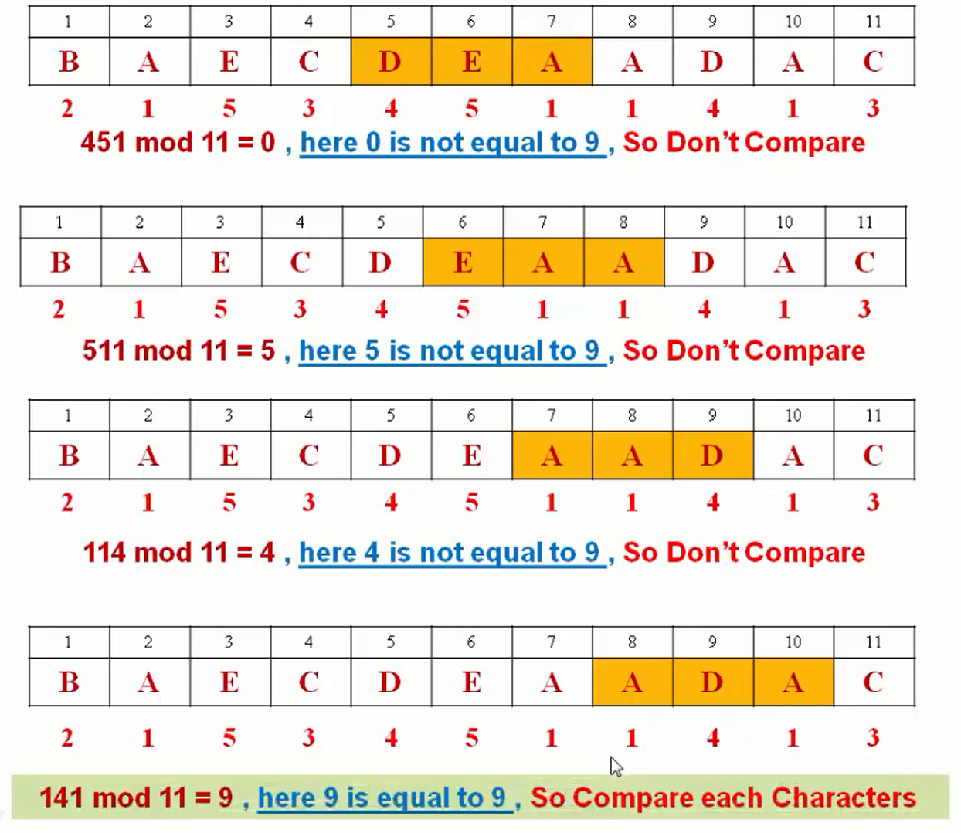
MIT School of Computing Department of Computer Science & Engineering
Rabin Karp algorithm
PLD

Slide 25
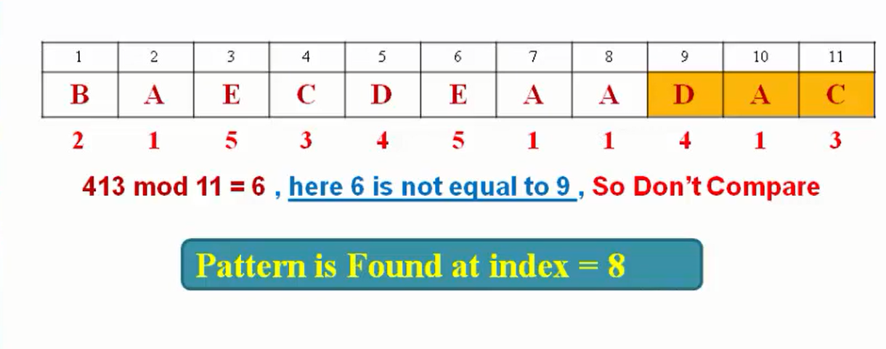
MIT School of Computing Department of Computer Science & Engineering
Rabin Karp algorithm
PLD

Slide 26
MIT School of Computing Department of Computer Science & Engineering
Rabin Karp algorithm
Complexity -
The running time of RABIN-KARP-MATCHER in the worst case scenario
O ((n-m+1) m
But it has a good average case running time.
PLD

Slide 27
MIT School of Computing Department of Computer Science & Engineering
Binary Search Algorithm -
Binary Search is a searching algorithm used in a sorted array by repeatedly dividing the search interval in half and the correct interval to find is decided based on the searched value and the mid value of the interval.
Properties of Binary Search:
Binary search is performed on the sorted data structure for example sorted array.
Searching is done by dividing the array into two halves.
It utilizes the divide-and-conquer approach to find an element.
Pre-requisites to apply Binary Search Algorithm:
For applying binary search in any data structure, the data structure must satisfy the following two conditions:
The data structure is sorted.
Any random element of the data structure can be directly accessed i.e., can be accessed in constant time.
PLD

Slide 28
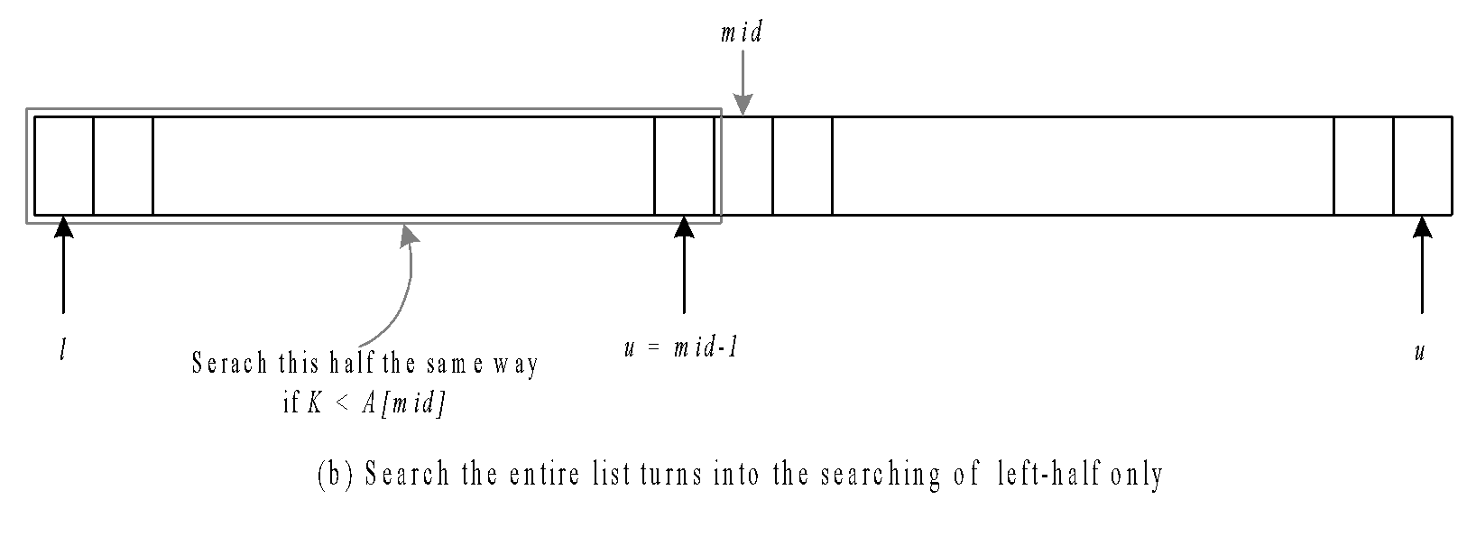
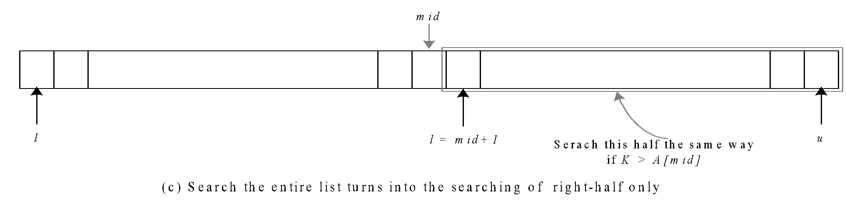
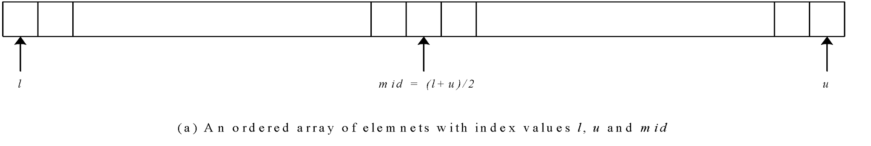
MIT School of Computing Department of Computer Science & Engineering
Technique
PLD
‹#›

Slide 29
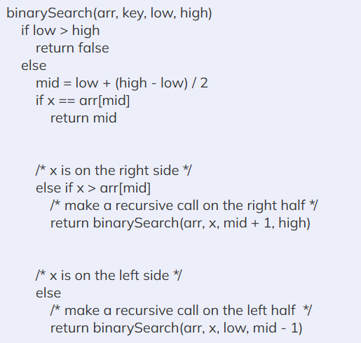
MIT School of Computing Department of Computer Science & Engineering
Algorithm
PLD
‹#›

Slide 30
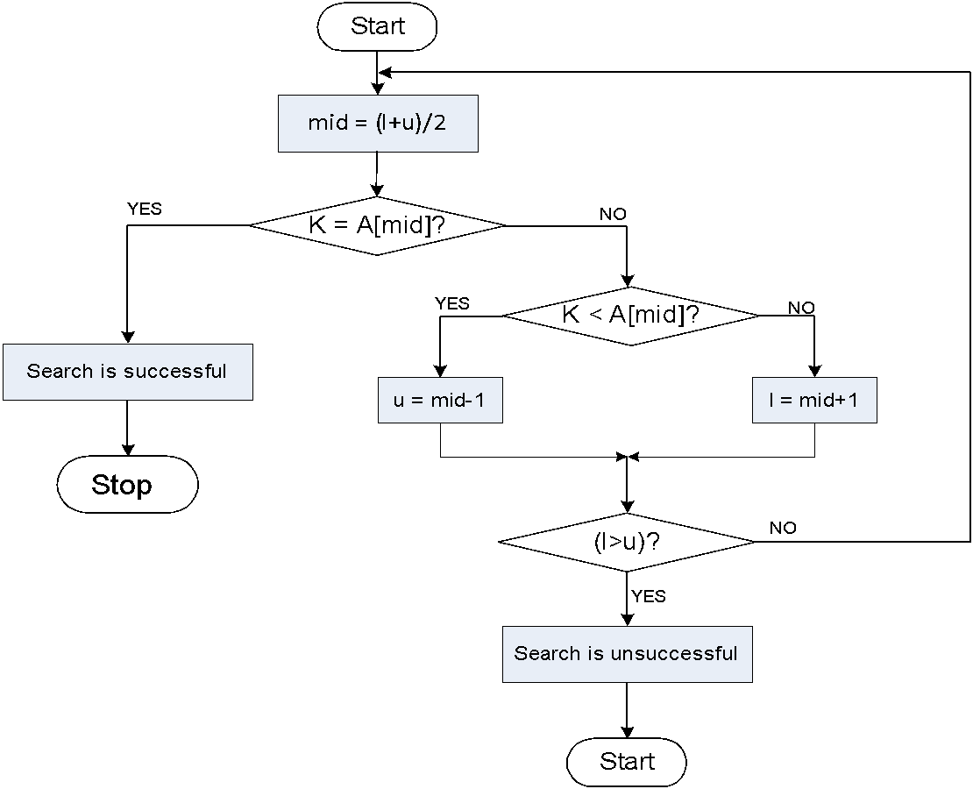
MIT School of Computing Department of Computer Science & Engineering
Flowchart
PLD

Slide 31
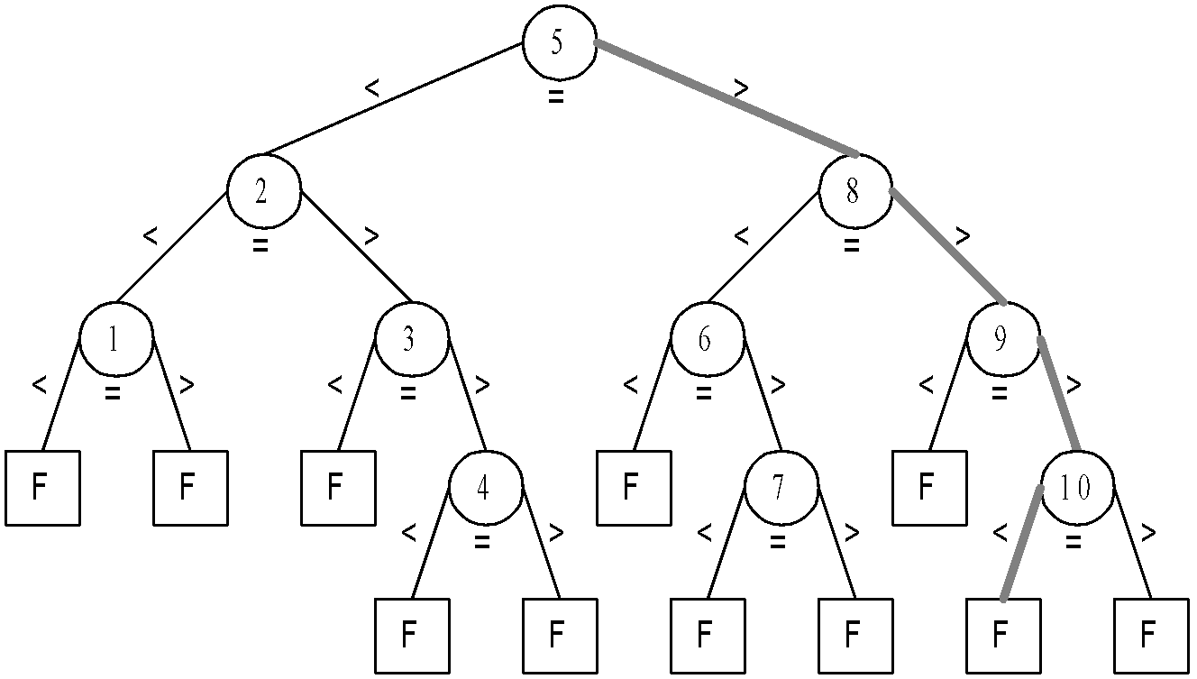
MIT School of Computing Department of Computer Science & Engineering
Complexity Analysis
PLD

Slide 32
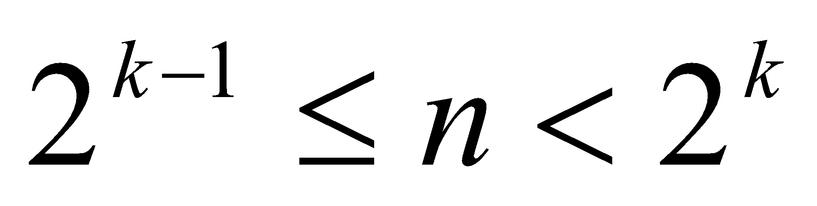
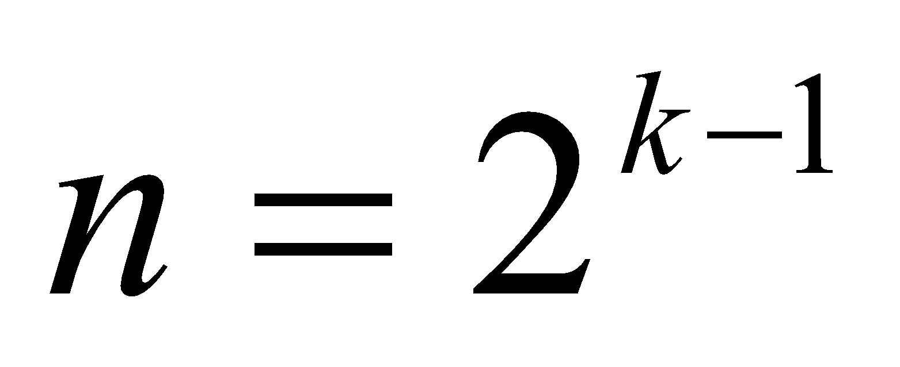
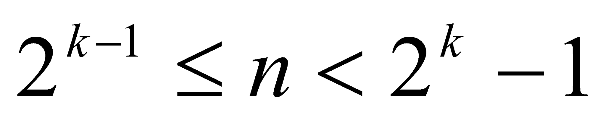
MIT School of Computing Department of Computer Science & Engineering
Let n be the total number of elements in the list under search and there exist an integer k such that:-
For successful search:-
If , then the binary search algorithm requires at least one comparison and at most k comparisons.
For unsuccessful search:-
If , then the binary search algorithm requires k comparisons.
If , then the binary search algorithm requires either k-1 or k number of comparisons
PLD

Slide 33
MIT School of Computing Department of Computer Science & Engineering
DIVIDE AND CONQUER
Divide and Conquer Algorithm involves breaking a larger problem into smaller subproblems, solving them independently, and then combining their solutions to solve the original problem.
The basic idea is to recursively divide the problem into smaller subproblems until they become simple enough to be solved directly. Once the solutions to the subproblems are obtained, they are then combined to produce the overall solution.
PLD

Slide 34
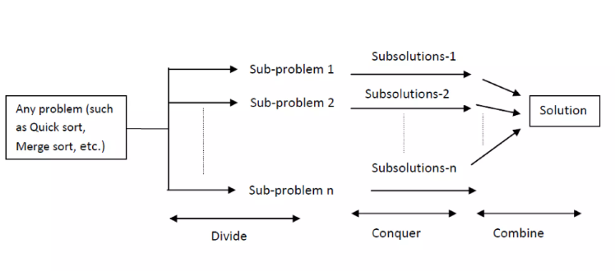
MIT School of Computing Department of Computer Science & Engineering
PLD

Slide 35
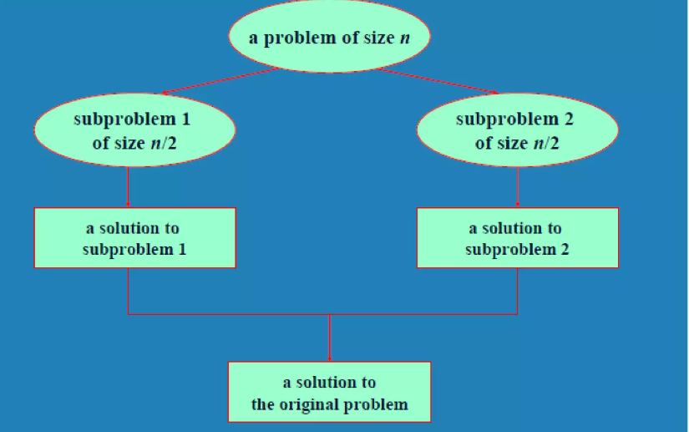
MIT School of Computing Department of Computer Science & Engineering
PLD

Slide 36
MIT School of Computing Department of Computer Science & Engineering
Merge Sort Algorithm:
Divide: If S has at least two elements (nothing needs to be done if S has zero or one elements), remove all the elements from S and put them into two sequences, S₁ and S₂, each containing about half of the elements of S. (i.e. S₁ contains the first ⎡n/2⎤ elements and S₂ contains the remaining ⎣n/2⎦ elements.
Recur: Recursive sort sequences S₁ and S₂.
Conquer: Put back the elements into S by merging the sorted sequences S₁ and S₂ into a unique sorted sequence.
Merge Sort Tree:
Take a binary tree T
Each node of T represents a recursive call of the merge sort algorithm.
We associate with each node v of T a the set of input passed to the invocation v represents.
The external nodes are associated with individual elements of S, upon which no recursion is called.
PLD

Slide 37
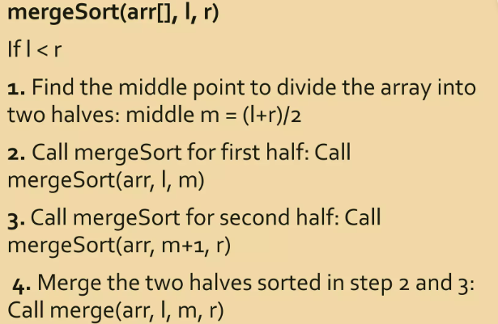
MIT School of Computing Department of Computer Science & Engineering
PLD

Slide 38
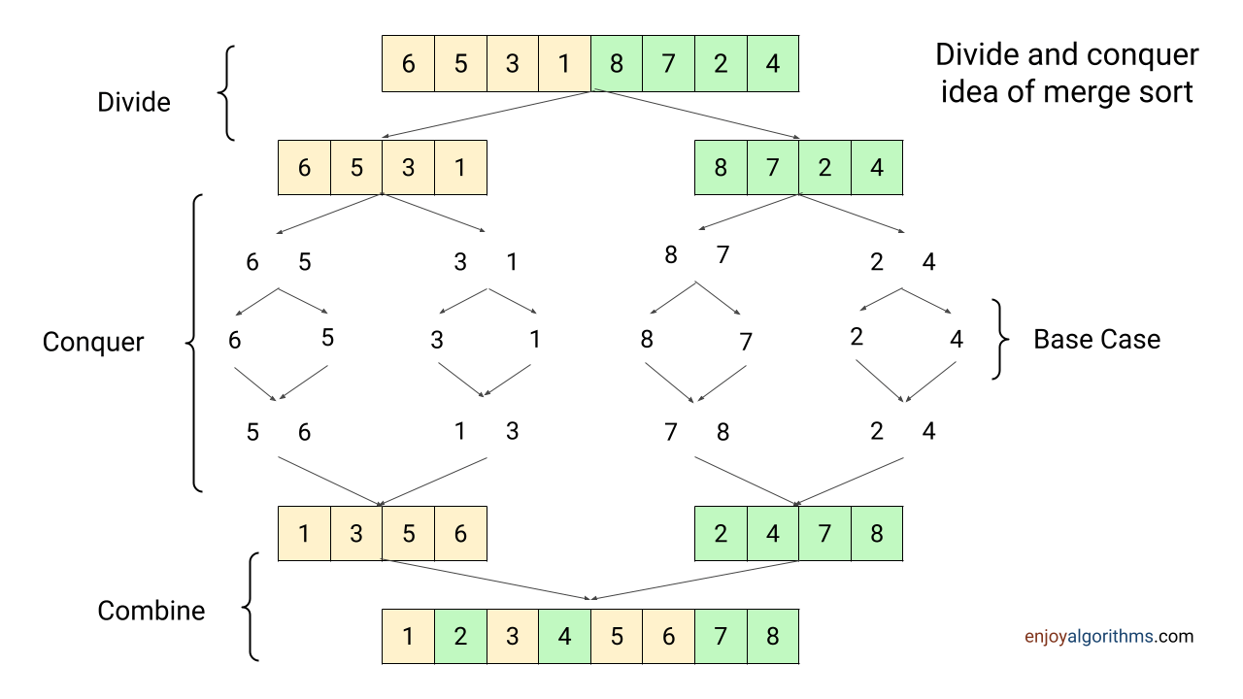
MIT School of Computing Department of Computer Science & Engineering
PLD

Slide 39
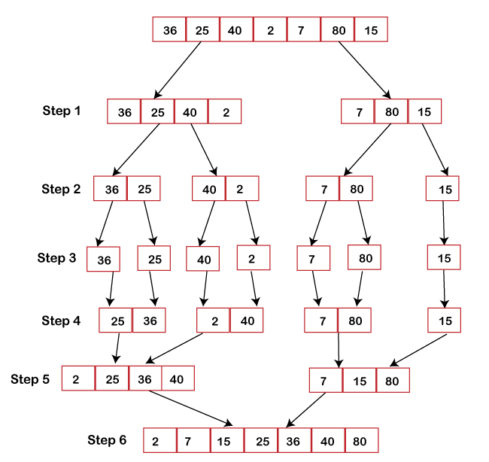
MIT School of Computing Department of Computer Science & Engineering
PLD

Slide 40
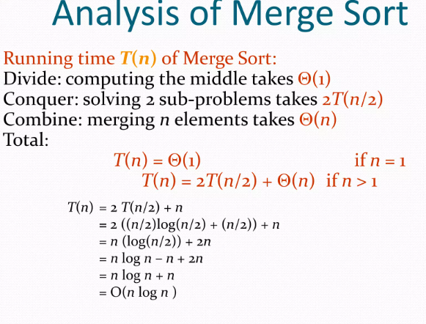
MIT School of Computing Department of Computer Science & Engineering
PLD

Slide 41
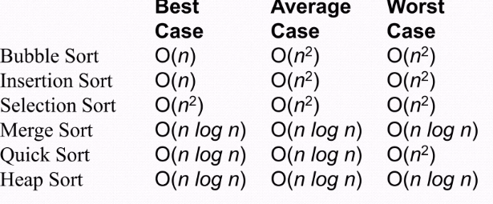
MIT School of Computing Department of Computer Science & Engineering
PLD

Slide 42
MIT School of Computing Department of Computer Science & Engineering
Quicksort I: Basic idea
Pick some number p from the array
Move all numbers less than p to the beginning of the array
Move all numbers greater than (or equal to) p to the end of the array
Quicksort the numbers less than p
Quicksort the numbers greater than or equal to p
PLD
p
numbers less than p
p
numbers greater than or equal to p

Slide 43
MIT School of Computing Department of Computer Science & Engineering
Quicksort I
To sort a[left...right]:
if left < right:
Partition a[left...right] such that:
all a[left...p-1] are less than a[p], and
all a[p+1...right] are >= a[p]
Quicksort a[left...p-1]
Quicksort a[p+1...right]
Terminate
PLD
‹#›

Slide 44
MIT School of Computing Department of Computer Science & Engineering
Partitioning I
Choose an array value (say, the first) to use as the pivot
Starting from the left end, find the first element that is greater than or equal to the pivot
Searching backward from the right end, find the first element that is less than the pivot
Interchange (swap) these two elements
Repeat, searching from where we left off, until done
‹#›

Slide 45
MIT School of Computing Department of Computer Science & Engineering
Partitioning II
To partition a[left...right]:
Set pivot = a[left], l = left + 1, r = right;
while l < r, do
while l < right & a[l] < pivot , set l = l + 1
while r > left & a[r] >= pivot , set r = r - 1
if l < r, swap a[l] and a[r]
Set a[left] = a[r], a[r] = pivot
Terminate
PLD

Slide 46
MIT School of Computing Department of Computer Science & Engineering
Example of Partitioning
choose pivot: 4 3 6 9 2 4 3 1 2 1 8 9 3 5 6
search: 4 3 6 9 2 4 3 1 2 1 8 9 3 5 6
swap: 4 3 3 9 2 4 3 1 2 1 8 9 6 5 6
search: 4 3 3 9 2 4 3 1 2 1 8 9 6 5 6
swap: 4 3 3 1 2 4 3 1 2 9 8 9 6 5 6
search: 4 3 3 1 2 4 3 1 2 9 8 9 6 5 6
swap: 4 3 3 1 2 2 3 1 4 9 8 9 6 5 6
search: 4 3 3 1 2 2 3 1 4 9 8 9 6 5 6 (left > right)
swap with pivot: 1 3 3 1 2 2 3 4 4 9 8 9 6 5 6
PLD

Slide 47
MIT School of Computing Department of Computer Science & Engineering
Typical case for quicksort
If the array is sorted to begin with, Quicksort is terrible: O(n²)
It is possible to construct other bad cases
However, Quicksort is usually O(n log₂n)
The constants are so good that Quicksort is generally the fastest algorithm known
Most real-world sorting is done by Quicksort
PLD
‹#›

Slide 48
MIT School of Computing Department of Computer Science & Engineering
Strassen’s Algorithm
Strassen's Matrix Multiplication is the divide and conquer approach to solve the matrix multiplication problems. The usual matrix multiplication method multiplies each row with each column to achieve the product matrix. The time complexity taken by this approach is O(n³), since it takes two loops to multiply. Strassen’s method was introduced to reduce the time complexity from O(n³) to O(n^{log 7}).
PLD

Slide 49
MIT School of Computing Department of Computer Science & Engineering
Strassen’s Algorithm
Multiply 2 x 2 Matrices:
| r s | | a b| |e g|
| t u| | c d| | f h|
Where:
p₁ = (b + d)(f + g)
p₂= (c + d)e
p₃= a(g – h)
p₄= d(f – e)
p₅= (a – b)h
p₆= (c – d)(e + g)
p₇= (b – d)(f + h)
=
PLD
r = p₁ + p₄ – p₅ + p₇
s = p₃ + p₅
t = p₂ + p₅
u = p₁ + p₃ – p₂ + p₇

